Slide 1
Specialist Services at Imperial
Muna Noori
Head of Specialty
Queen Charlotte’s & Chelsea Hospital

Slide 2

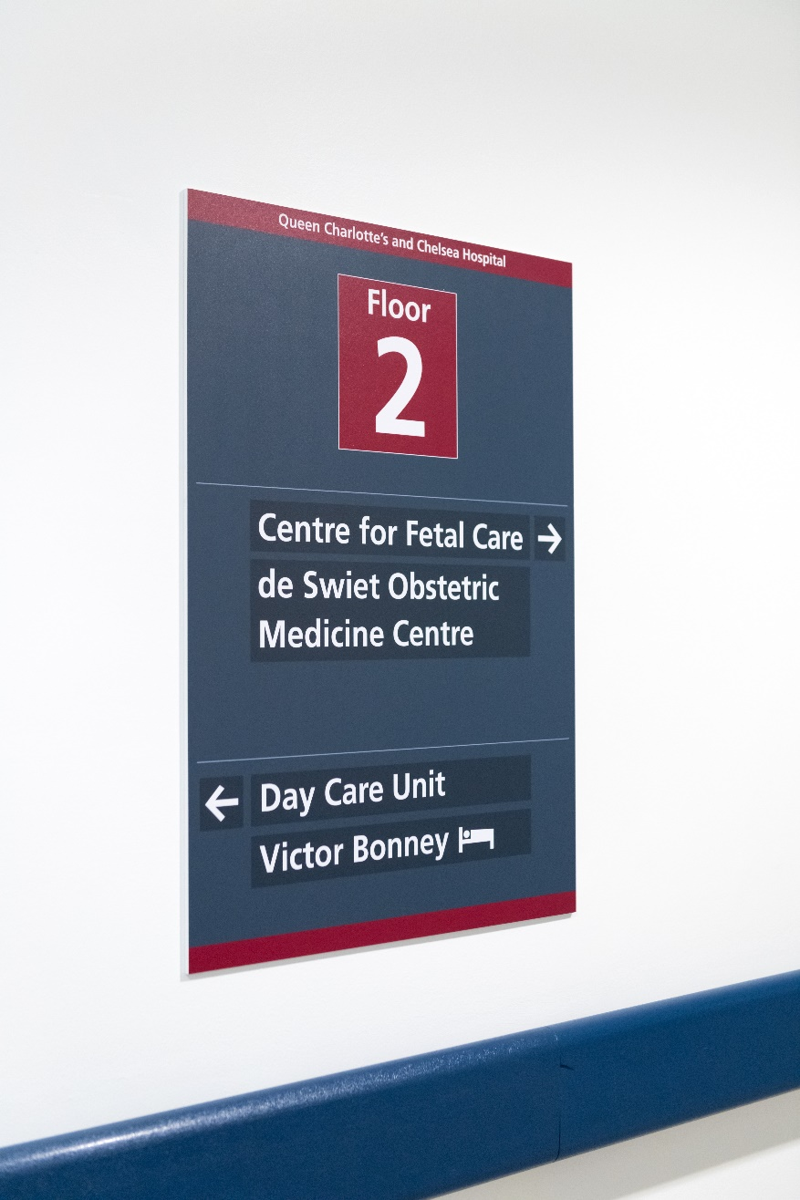
Specialist Services
Maternal Medicine
Fetal Medicine
Perinatal Mental Health Services
Prematurity Services

Slide 3




MBRRACE-UK: Mothers and Babies: Reducing Risk through Audits and Confidential Enquiries across the UK

Slide 4
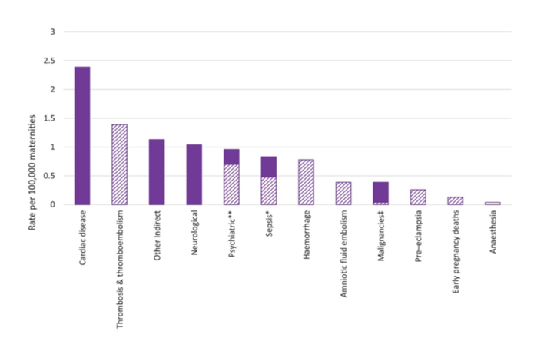
Causes of maternal death 2014-2016

Slide 5
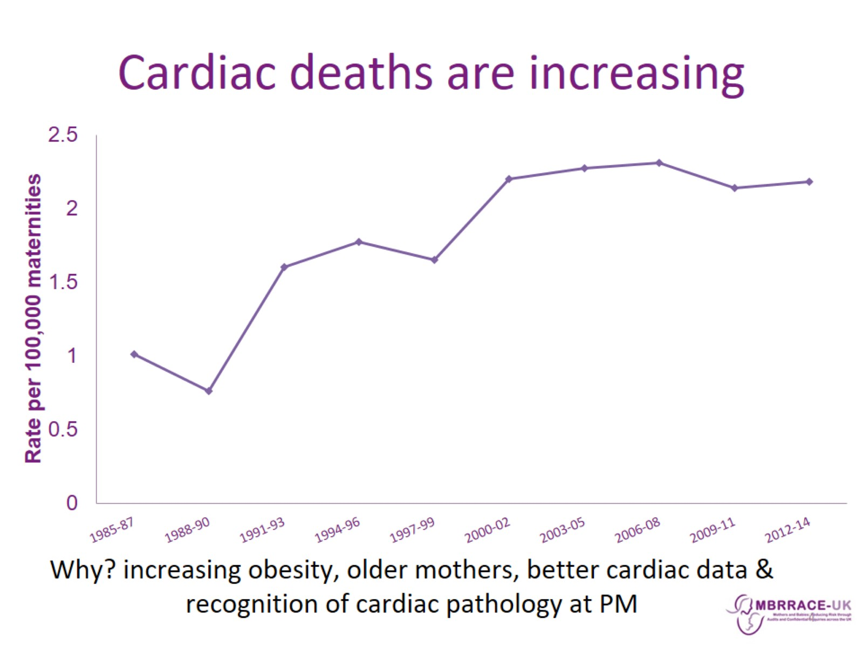
Cardiac deaths
2012-2014 – 2 per 100,000 women died from heart disease
2009 -2014 189 cardiac deaths in UK and Ireland
Women with cardiac risk factors (older maternal age, obesity) should undergo cardiac assessment prior to assisted reproductive / fertility treatment
Low threshold for investigating women with risk factors
Investigations should not be withheld because of pregnancy
Multi-disciplinary working
Need for communication between specialities, including primary care

Slide 6
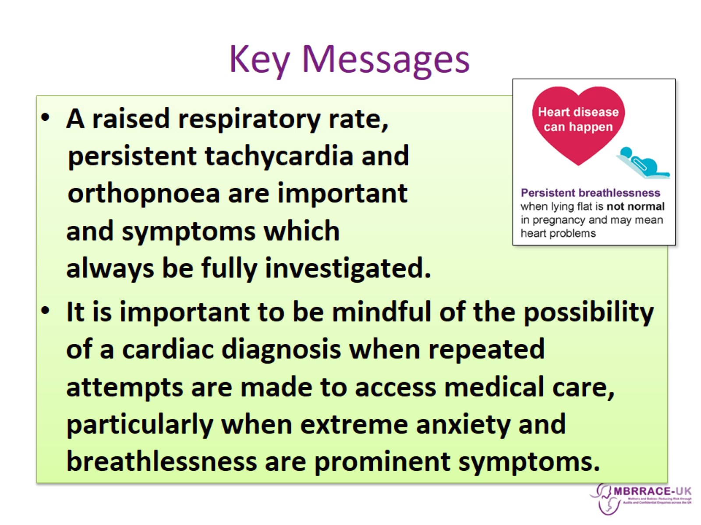
Delayed cardiac diagnosis
A pregnant woman presented on five occasions within two weeks to different hospitals and her GP complaining of cough, dyspnoea and orthopnoea. She was tachycardic. She was prescribed multiple curses of antibiotics to which she failed to respond. No further investigations were done. Eventually a diagnosis of peripartum cardiomyopathy was made and she was delivered by LSCS. Despite insertion of a balloon pump, ECMO and attempted LVAD insertion, she died shortly after delivery.

Slide 7
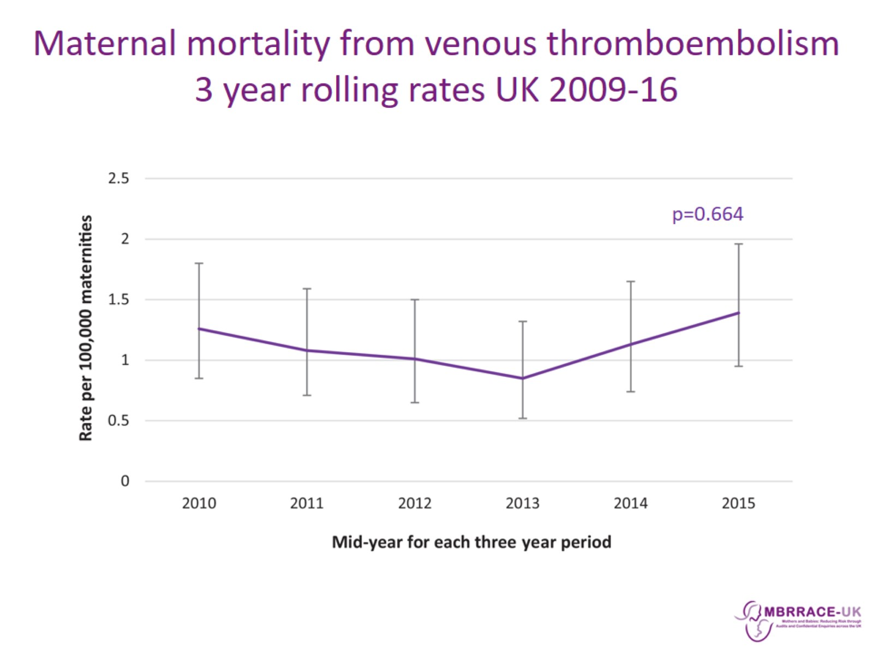
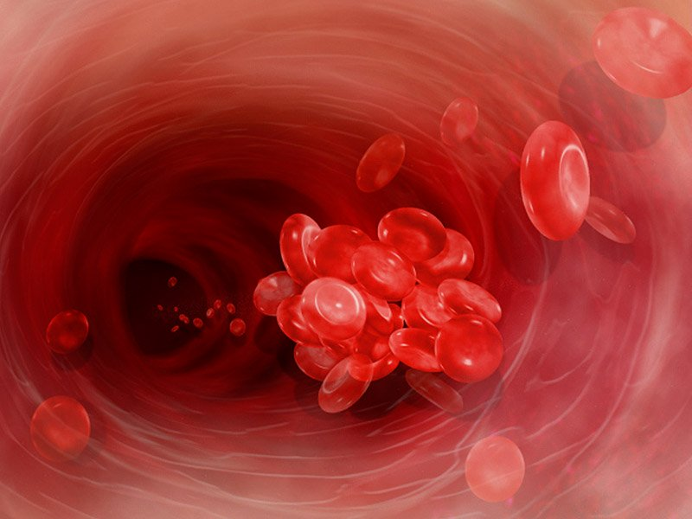
Venous thromboembolism
Pulmonary embolism is the leading cause of direct death in pregnancy
Many fatal antenatal VTE events occur in the first trimester and therefore prophylaxis for women with previous VTE should begin early in pregnancy
Highest risk is postpartum (peaks at 3 weeks postpartum)
VTE risk varies from 21-84 fold from baseline non-pregnant, non-postpartum rates
Women currently undergo a VTE risk assessment at booking, each admission, and post-delivery

Slide 8
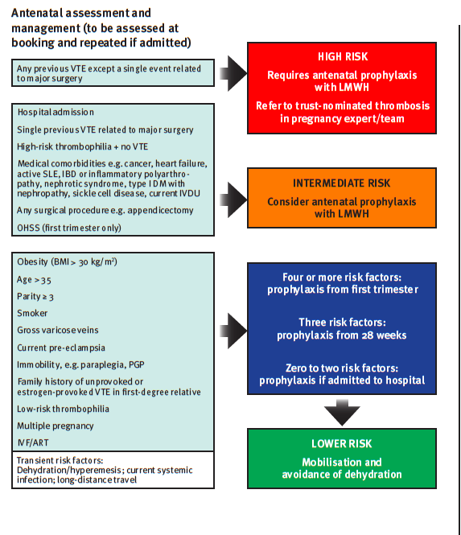
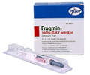
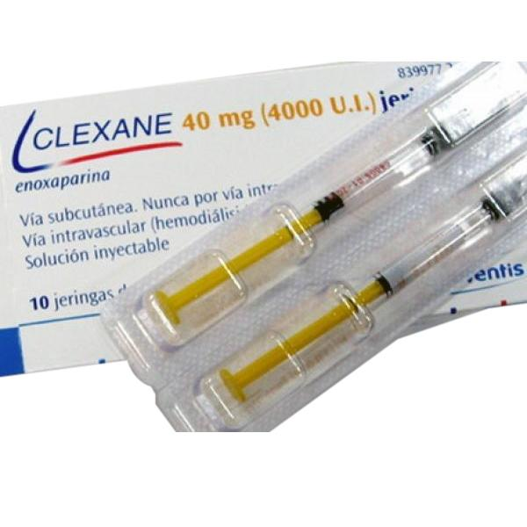
Assessing the need for thromboprophylaxis in pregnancy
RCOG Green-top Guideline No.37a, April 2015

Slide 9
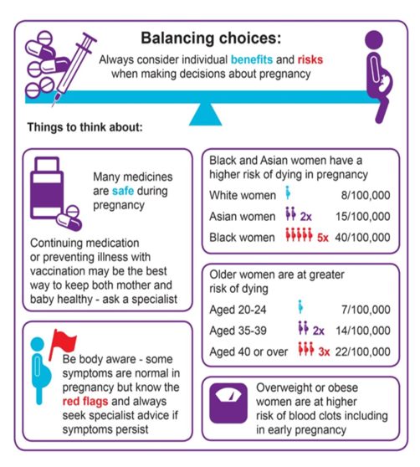
Optimising health in preparation for pregnancy

Slide 10
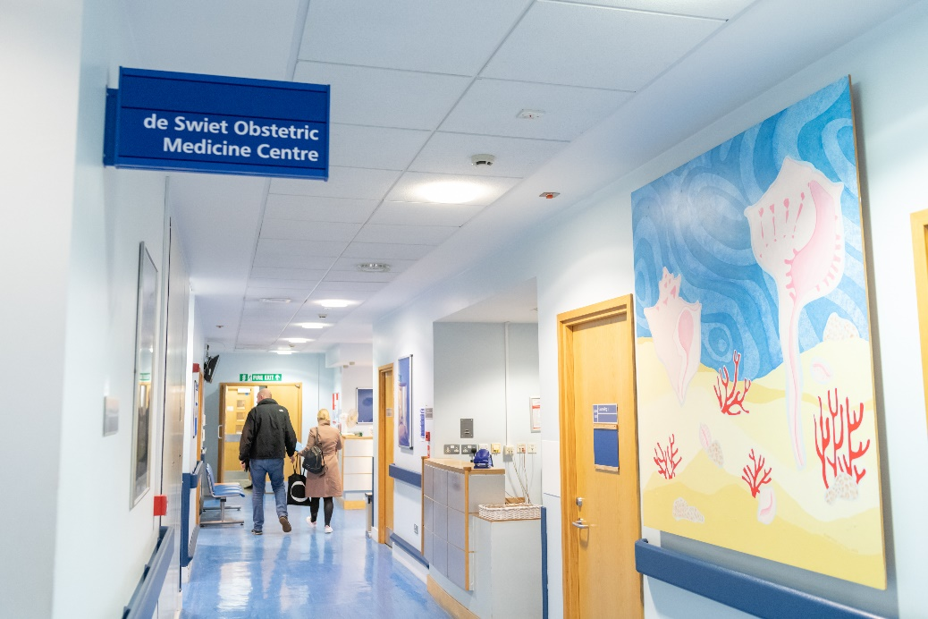
Maternal medicine services
High risk pregnancy clinics on both sites
de Swiet Obstetric medicine Unit at QCCH
Tertiary service with obstetric physicians and physicians with an interest in maternal medicine
Multidisciplinary clinics for:
Haematology Rheumatology
Neurology Cardiovascular
Renal Liver
Endocrine Gastroenterology
Diabetes

Slide 11
Optimising women’s health prior to pregnancy
Pre-pregnancy counselling services (PPC)
Women with pre-existing medical conditions should receive pre-pregnancy counselling by a specialist – preferably an Obstetric Physician or a specialist with an interest in Maternal Medicine to discuss:
implications of their condition on their pregnancy and vice versa
Optimisation of their health prior to conception
safety of current drug therapies
Women with pre-existing medical disorders of pregnancy (including hypertension and diabetes), or risk factors including advanced age and raised BMI, should also be referred for PPC prior to Assisted Reproductive Techniques (ART) / fertility treatment

Slide 12


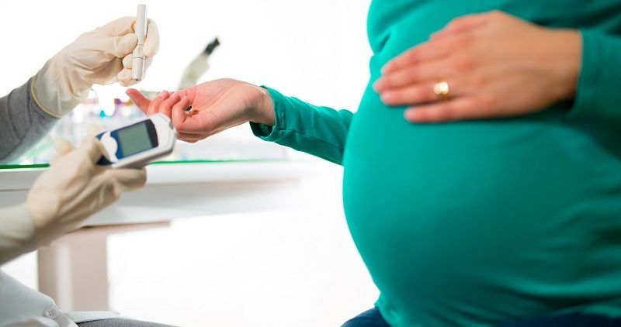

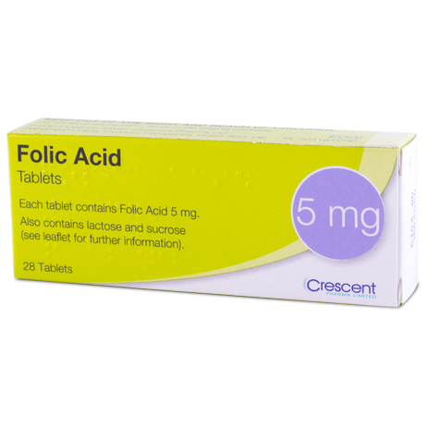
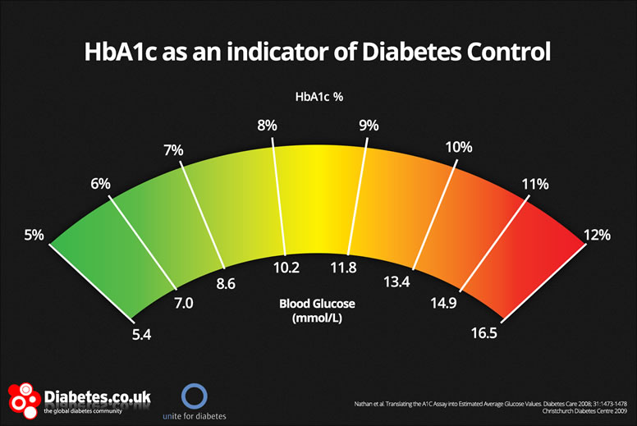
Diabetes – optimising women’s health

Slide 14
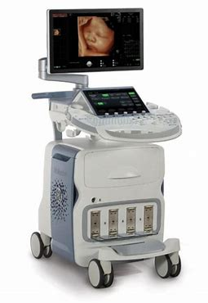
Fetal medicine services
Centre for Fetal Care at QCCH (tertiary service)
Fetal medicine Unit at SMH
Non-invasive prenatal testing
Invasive testing (CVS and amnio)
Fetal transfusions
MCDA twins & high order multiple pregnancies
Radiofrequency ablation (RFA)
Selective/multifetal reduction
Laser ablation for TTTS
Treatment within 24 hours, cross cover for laser with King’s College Hospital
To start in May 2019:
First human studies of HIFU (high intensity focused ultrasound) in TTTS
(MRC funded £2.2M DPFS study)

Slide 15
Fetal medicine services @ QCCH
RCOG training approved tertiary fetal medicine unit for local, regional and national referrals
All diagnostic and therapeutic fetal medicine offered (laser, transfusion etc)
6 Fetal Medicine specialists/subspecialists
3 RCOG Subspecialty fellows
4 Clinical fellows
4 Fetal Medicine Midwives
2 dedicated administrators
1 Genetic counsellor
4000 patients per annum
Referrals and reports dealt with by secure email
Video MDT sessions weekly with local units (Monday morning) & fortnightly with Chelsea & Westminster (surgical cases)
CFCREFERRALS (IMPERIAL COLLEGE HEALTHCARE NHS TRUST)
ICHC-tr.cfcreferrals@nhs.net

Slide 16
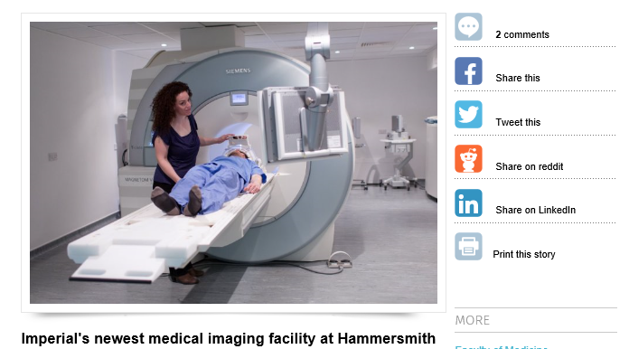
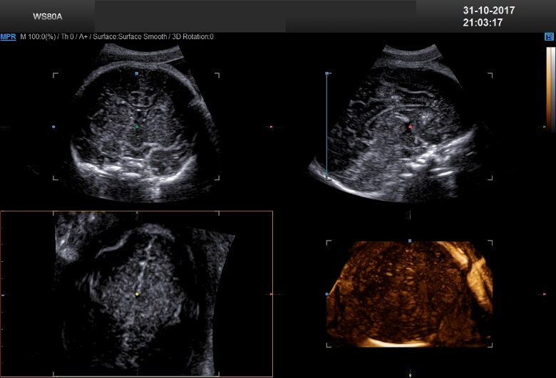
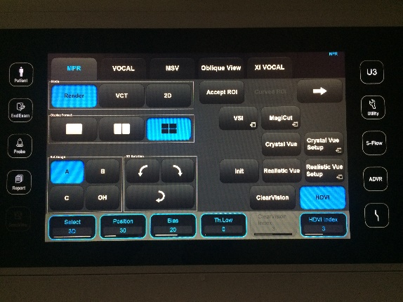
Fetal neurology @ CFC
Collaboration with the Department of Perinatal Neurology (Dr N Basheer)
Regional & National antenatal diagnostic and counseling service to families and clinicians with fetal neurological concerns
3D state of the art US imaging
On site MRI –weekly appointments and urgent

Slide 17
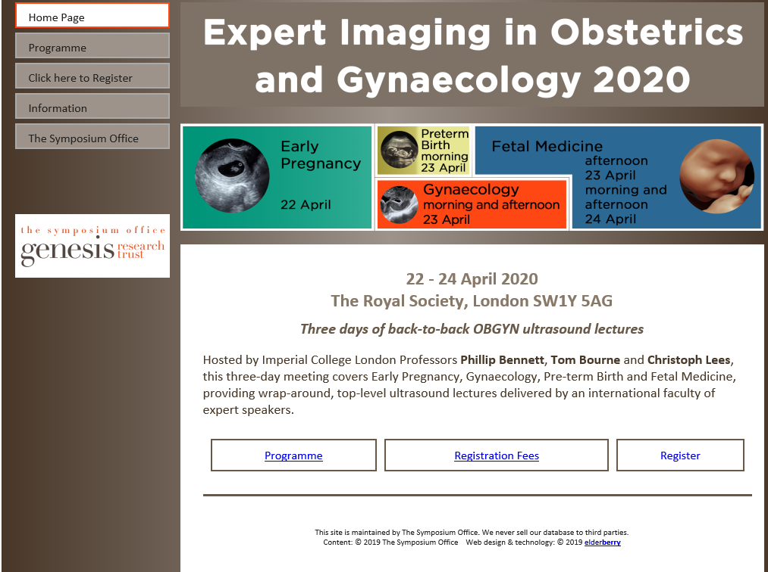
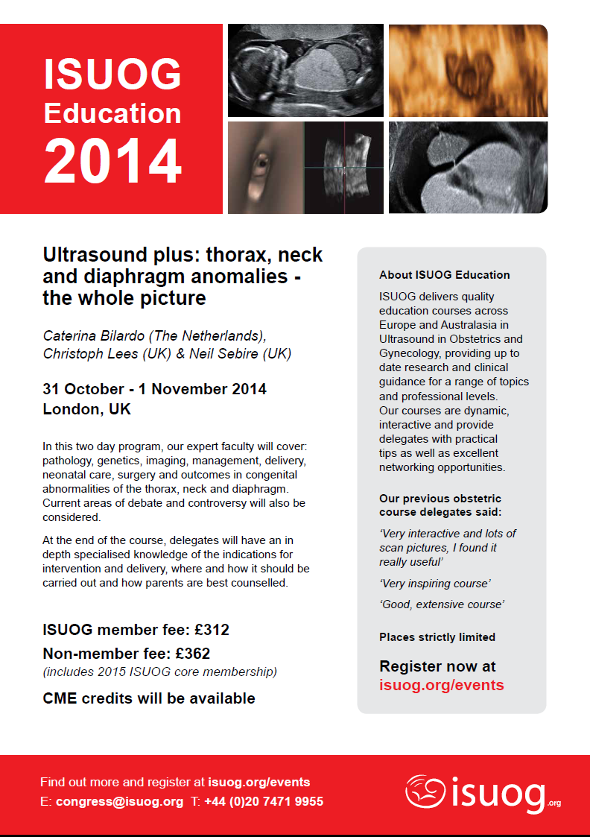
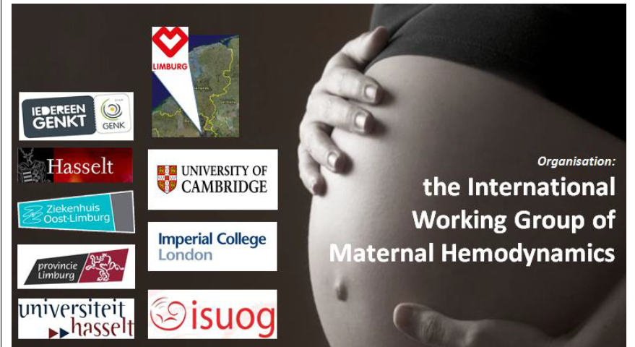
Fetal medicine research and training
www.symposia.org.uk

Slide 19
Perinatal mental health services
Up to 20% of women develop a mental health problem during pregnancy or within a year of giving birth
Spectrum of disorders
MILD
Depression
Anxiety
Baby Blues
MODERATE
Depression
Anxiety
Tokophobia
PTSD
OCD
Sub Misuse
Personality Disorder
SEVERE & ENDURING
Bipolar Affective Disorder
Schizophrenia
Schizoaffective Disorder
Severe depression +/- psychosis
Postpartum Psychosis

Slide 20
Adverse outcomes
Fetal & infant death
Obstetric complications
Attachment & bonding problems
Suicide
Emotional & behavioural problems
Accidents, neglect, abuse
Developmental / cognitive delay

Slide 21
Suicide
Psychiatric disorder is a leading cause of maternal mortality
At least 60% had SMI
50% first onset and 50% recurrence of Sz/BPAD
50% had INITIAL diagnosis of anxiety or PND
Single best predictor of risk is previous psychiatric illness
<50% had risk identified at booking & of those that did few had care plans in place
Onset illness to death – median 9 DAYS

Slide 22
Prescribing principles
AVOID ABRUPT CESSATION OF MEDICATION
Lowest dose
Avoid multiple drugs
Timing of exposure during pregnancy
Presence in breast milk
Anti-depressants
Continuity of treatment where needed
Risks of swapping/stopping
Most tolerated/lower risk: Sertraline
Alternatives: Tricyclic antidepressants
Cautions: Venlafaxine (High BP) Paroxetine (malformations)
Avoid: Sodium valproate
Newer medications- less knowledge
Seek advice if unsure
Web-based Resources
Toxbase | BUMPS | LactMed

Slide 23
Multi-agency working is central
Mother & family
IAPT
Primary Care
Health visiting
Maternity care
Mental Health Services
Mother & Baby Unit
Voluntary Sector
Social care

Slide 24
Referring to Imperial PNMH services
Specialist Services at St Mary’s & QCCH
Perinatal psychiatrists
Dr Maddalena Miele (SMH) – 0207 312 1582
Dr Sarah Taha – 0208 383 3033
Obstetricians
Miss Karen Joash (QCCH)
Miss Shankari Arulkumaran (SMH)
Specialist Midwife
Dionne Levy
Who to refer?
Any woman with SMI
Any woman that has not responded to interventions in primary care
Please call for advice

Slide 26
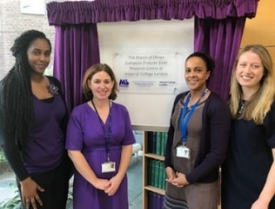
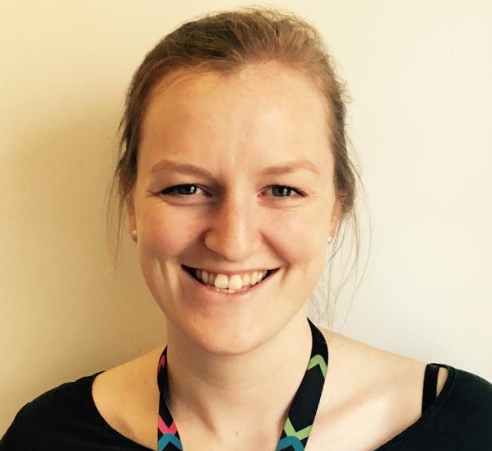
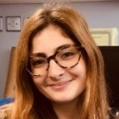



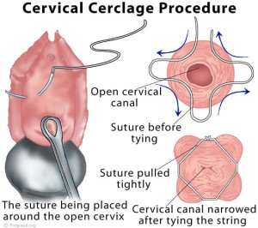
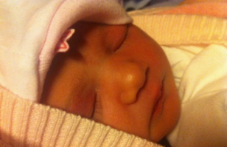
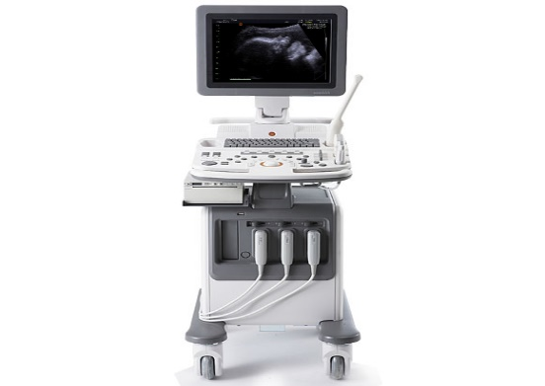


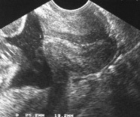
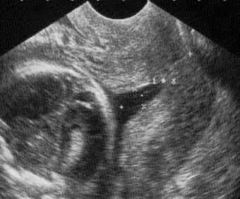
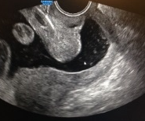
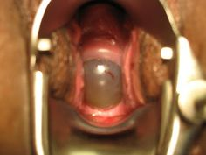
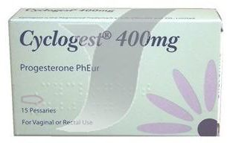
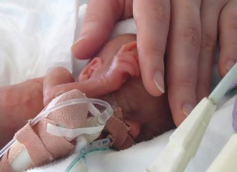
Prematurity Services
European March of Dimes Preterm Birth Research Centre
Booking
PTL/MTL/LETZ/ Uterine anomaly/
prev FD section
TVUSS 12-28 weeks
Every 2-3 weeks
Phillip Bennett
TG Teoh

Slide 27

Saving Babies’ Lives Care Bundle Version 2
National ambition to halve stillbirths and neonatal baby deaths by 2025
Element 1 Reducing smoking in pregnancy
Element 2 Risk assessment, prevention and surveillance of pregnancies at risk of fetal growth restriction
Element 3 Raising awareness of reduced fetal movements
Element 4 Effective fetal monitoring during labour
Element 5 Reducing preterm birth

Slide 28
Risk factors for preterm birth
Call to reduce PTB rates from 8% to 6% by 2025
High risk | Intermediate risk
Previous preterm birth of mid-trimester loss (16-34 weeks) | Previous delivery by Caesarean section at full dilatation
Previous preterm labour rupture of membranes <34 weeks | History of significant cervical excisional event ie. LLETZ where >10mm depth removed, or >1 LLETZ procedure, or cone biopsy
Previous use of cervical cerclage
Known uterine variant
Intrauterine adhesions (Ashermans syndrome
History of trachelectomy (for cervical cancer)

Slide 29
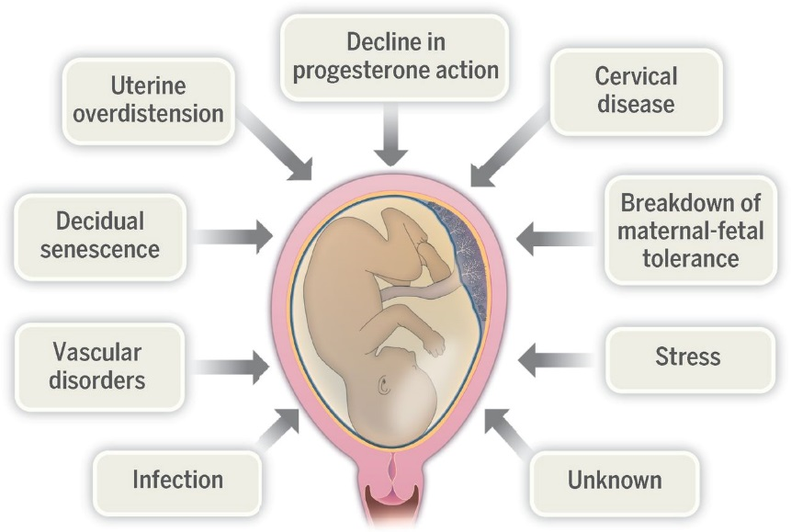

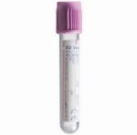
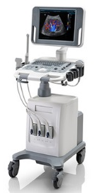




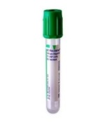

Understanding the individual's immune response to vaginal flora and how this relates to their risk of preterm labour
Recruitment and sample collection
12-16 weeks
20-24 weeks
30-34 weeks
Metadata collection

Slide 30
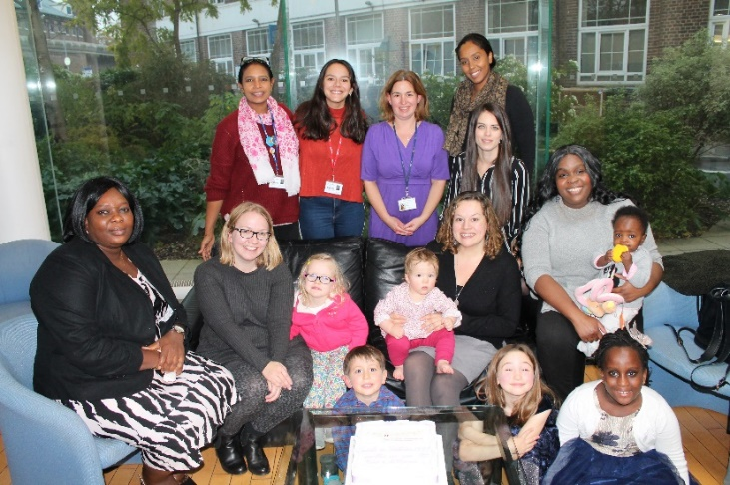

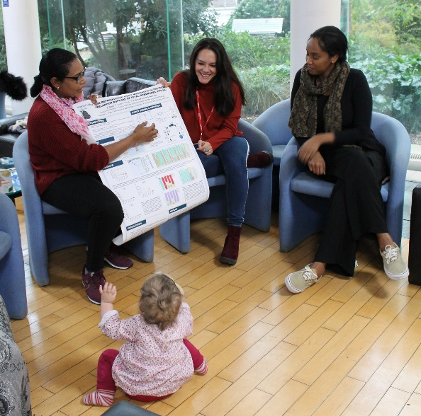
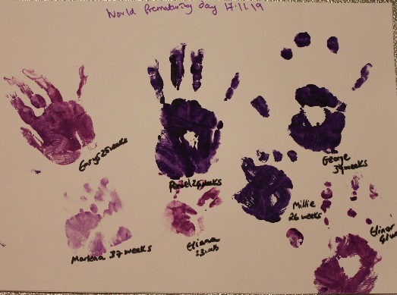
Preterm Birth Social Media and Parent Involvement
https://www.youtube.com/watch?v=3iuvXjJ0QC8&feature=youtu.be
https://twitter.com/drlynnesykes?lang=en

Slide 31
Thank you

