Slide 1
Dr Anne Kinderlerer

Slide 2
Learning Objectives
Upon completion of this activity, participants should be able to:
Assess the child or young person with musculoskeletal symptoms
Develop a logical and consistent approach to identify inflammatory joint symptoms
Consider a structured approach to psychosocial history taking in adolescents
I have not included a discussion of common orthopaedic conditions in children – eg perthes , severs disease

Slide 3
Children are not small adults and:
Most MSK presentations in childhood are benign, self-limiting and often trauma related;
Arthritis in children – is an untimely illness – we perceive arthritis as a disease of old age
Many of the principles of diagnosing and treating musculoskeletal symptoms in children are the same as in adults but the bio-psycho-social setting is different

Slide 5
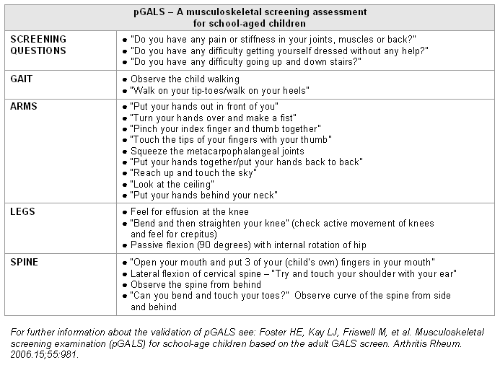

Slide 6
RED FLAGS (to raise concern about infection, or malignancy or non-accidental injury)
Fever, systemic upset (malaise, weight loss, night sweats)
Lymphadenopathy, hepatosplenomegaly
Bone pain ( ? Unremitting)
Persistent night waking
Back pain in under 6
Incongruence between history and presentation/pattern of physical findings

Slide 7
Test | condition | Diagnostic use | When to use
FBC | SLE / inflammation | Normal in JIA + 66% of children leukaemia Abnormal SO JIA / infection ? SLE | Initial blood test chronic joint pain
ESR / CRP | Inflammation | Often normal If abnormal – suggest underlying condition | Initial blood test chronic pain
ANA / DS DNA / ENA | JIA / SLE | +ve 20% of normal population In JIA risk of Uveitis | If JIA / SLE likely
RF | Polyarticular –RF positive |  | Adolescent – looks like Rheumatoid
HLA B27 | ERA |  | Suspect ERA
CK | dermatomyositis |  | Muscle pain / weakness
Vitamin D | Rickets / osteomalacia | No evidence improves chronic pain

Slide 8
Radiology | Condition | When to use
Plain films | Bone tumours / fractures/ osteomyelitis / rickets | Significant bone pain
US | synovitis | ? Septic arthritis / diagnostic uncertainty- effusion
MRI | Synovitis / perthes/ osteomyelitis/ ERA | Useful where examination difficult – hip Excldue osteomyelitis

Slide 9
Case 1
5 year old hx of persistent back pain
Multiple presentations to local hospital – ID service here
Hx of fever
Severe back pain – stopped being able to walk
MRI scan – completely normal

Slide 10
Pain in children and young people
The prevalence of MSK pain approaches adult levels by the end of adolescence.
83% school aged children ( Germany)
30.8% pain present more than 6 /12 – headache 60% abdo pain 43.3%, limb pain 33.6%, back pain 30.2%
Girls > boys
Deprivation index 1.4 x rate of pain
Persistent adolescent MSK pain is a risk factor for chronic pain in adulthood.
MSK pain has substantial impacts in up to 1/4 of cases.
The relationship of other adverse health risk factors and MSK pain is unclear.
There is little research to inform clinical management of childhood MSK pain.

Slide 11
Chronic pain
Idiopathic nocturnal leg pain / growing pains
Recurrent lower limb arthralgia
Anterior knee pain
Diffuse idiopathic pain / CRPS / juvenile fibromyalgia
Juvenile hypermobility syndrome
Back pain

Slide 12
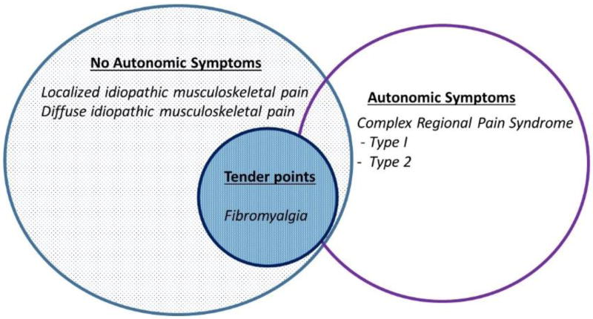

Slide 13
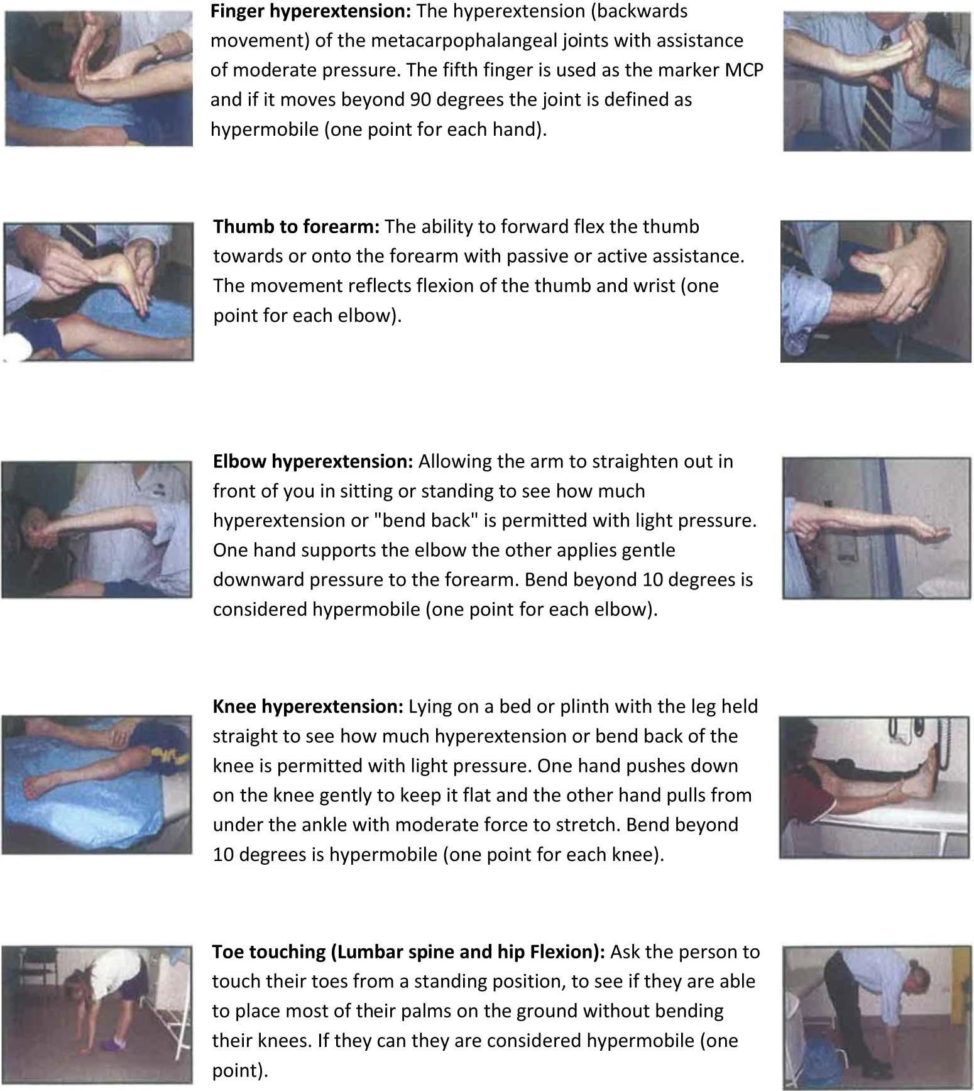

Slide 14
Yunus & Masi Suggested Criteria for Childhood Fibromyalgia Syndrome
(All Four Major and Three Minor or the First Three Major and Four Painful Sites
and Five Minor Needed)
Major:
Generalized musculoskeletal aching at three or more sites for three or more months
Absence of underlying condition or cause
Normal laboratory tests
Five or more typical tender points*
Minor
Chronic anxiety or tension
Fatigue
Poor sleep
Chronic headaches
Irritable bowel syndrome
Subjective soft tissue swelling
Numbness
Pain modulation by physical activities
Pain modulation by weather factors
Pain modulation by anxiety or stress
*the original paper listed 31 tender points but after 1990 ACR criteria paper most people used the 18 tender points listed on Table 2.

Slide 15
Case 2
13 year old boy ( year 8 )
Severe pain / fatigue back and legs
Attending less than 30% of school
Mother has fibromyalgia
Mother dominated consultation

Slide 16
HEADSS
Home
Education / Employment
Eating
Activities ( peer group)
Drugs / Alcohol
Sexuality/ sexual activity
Suicide / depression

Slide 17
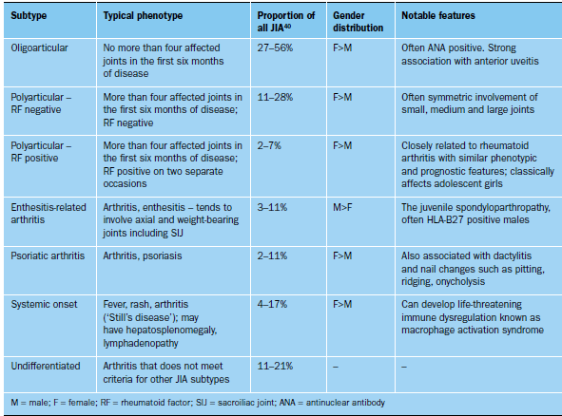

Slide 18
Case 3
3 year old presented to ED with a limp
Hip xrays normal
Knee felt to be normal on examination by ED consultant / paeds reg
A
ANA +ve
US - R knee effusion
Dx oligoarticular JIA
Remission following IA steroid

Slide 19
Case 4
18 years old
Dx JHS for 11 years
Both knees swollen – unable to extend
Fully Ix low Hb
However CRP 140
Damage at hips , knees – and fusion SI joints on xray
Dx ERA – rx iv methyl prednisolone / MTX / Anti -TNF

Slide 20
Case 5
17 year old boy
Presented acute take – fever SOB , consolidation on xray
However
3/12 hx pain and swelling in hands hard to write

Slide 21
Paediatric Rheumatology at ICHNT
Joint clinics – paediatric / adolescent
Radiology MDT orthopaedics
Network GOSH
Email – please mark for attention Dr Kinderlerer / Dr Malbon

