Slide 1
Alcohol Related Liver Disease
Dr Heather Lewis
Hepatology Consultant
Imperial College Healthcare NHS Trust

Slide 2
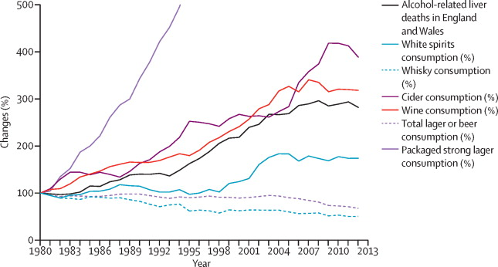
Rising mortality from alcohol related liver disease
Mortality from liver disease in the UK
(Williams et al, The Lancet 2014)
Alcohol related liver disease deaths
and consumption
(ONS and HMRC)
Notes:
There has been an 88% rise in age-standardised mortality from chronic liver disease
Cirrhosis deaths are rising in England while falling in most other EU countries
Average age of death from ARLD is 59
Alcohol has become 60% more affordable since 1980
Alcohol misuse costs the NHS £3.5 billion per year
In Europe alcohol is responsible for 6.5% of all deaths, and 11.6% of DALYs
PHE estimates 23,839 alcohol related deaths in England in 2016, 65% ARLD and 23% liver cirrhosis and unspecified other diseases of liver
1.1 million alcohol related admissions (PHE 2017)

Slide 3
Alcohol related mortality in England by deprivation
PHE 2016
Notes:
The most deprived lifestyle group have:
64% higher alcohol related mortality
4‐15 times greater alcohol‐specific mortality
Up to 10 times greater alcohol‐specific admissions to hospital
66% of those dying with ARLD are male
50% of homeless people are dependent upon alcohol
Psychiatric co‐morbidity is common among problem drinkers
Up to 10% for severe mental illnesses
50‐80% for personality or neurotic disorders.

Slide 4
Alcohol Related liver disease
Dear Doctor,
Re: Deranged LFTs
Thank you for seeing this 64 year old patient who was noted to have markedly deranged LFTs on routine bloods done in January for medication monitoring. His ALT had risen to 126, on a background of known fatty liver disease, with normal platelets and albumin. He admitted to drinking one box of wine and a bottle of brandy every week but did not drink daily. He also smokes 20 cigarettes per day.
A scan demonstrated diffuse fatty liver and likely alcoholic liver disease. The remainder of his liver screen was unremarkable (see below), however he has just been referred for an urgent OGD in view of dyspeptic symptoms with a slight drop in Hb to 12.5.
His past medical history includes hypertension , high cholesterol and a previous MI. His regular medications are listed below.
Thank you for seeing him for further assessment and to consider the need for a fibroscan.

Slide 5
Screening in primary care
AUDIT questionnaire sent to participants
AUDIT > 8 – invited to have STL test in nurse led clinic in GP practice
24% (1128/4630) AUDIT positive
(Sheron et al, 2013)

Slide 6
Results
Normal LFT’s in:
90% of people with early alcohol-related fibrosis
75% of people with severe fibrosis
75% of 1st admissions with cirrhosis/ liver failure not seen prev
78% had AUDIT 8-15 - hazardous
22% had AUDIT > 15 – dependent
Fibrosis:
Green – 49% (191/393)
Amber – 40% (157/393)
Red – 11% (45/393)
(Sheron et al, 2013)

Slide 7
Transient Elastography for prediction of fibrosis in ALD
Fibrosis score | TE cut off value | Sensitivity | Specificity
> F1 | 5.9kPa | 83% | 86%
F2 or above | 7.5 kPa | 94% | 89%
F3 or above | 9.5kPa | 92% | 68%
F4 | 12.5kPa | 95% | 71%
Pavlov et al, Cochrane Database systemic review, 2015

Slide 8
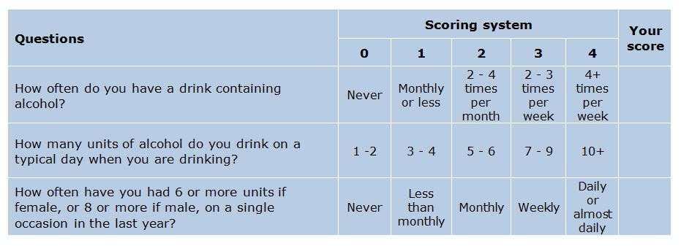
AUDIT and AUDIT-C

Slide 9
AUDIT accuracy in detecting AUD
 | Men (AUROC) |  |  | Women (AUROC)
 | Cut off | AUDIT | AUDIT-C | Cut off | AUDIT | AUDIT-C
Hazardous drinker | 9 | 0.79 | 0.82 | 4 | 0.84 | 0.85
Alcohol abuse | 10 | 0.62 | NA | 5 | 0.65 | NA
Alcohol dependence | 12 | 0.77 | NA | 7 | 0.76 | NA
AUD | 10 | 0.70 | NA | 6 | 0.73 | NA
Score of > 8 indicates hazardous/ harmful drinking
Score of > 16 indicates dependence
Foxcroft, DR et al 2015
Notes:
AUDIT takes 2-5 minutes
AUDIT-C takes 1-2 minutes – 3 questions

Slide 10
Alcohol Related Liver Disease
Notes:
90% of people with early ARLD and 73% with advanced fibrosis have normal LFTs
Alcohol-related cirrhosis is the the most common cause of
liver-related mortality in Western populations. The majority
of patients with this condition are heavy daily drinkers, with
a median alcohol consumption of around 120 units/week.
Notably, 25% of the population drink more than recommended
guidelines (≤14 units/week), with 10% drinking twice as much
and 1.4% drinking more than 75 units/week.3 The relationship
between alcohol consumption and liver cirrhosis is exponential;
at 20 units/week the relative risk is approximately 3, whereas at
80 units/week it is 30.1
The Lancet Commission recommended the use of AUDIT-C as a
first-line screening tool in high-risk groups followed by the full
10-item AUDIT to determine when to look for liver disease.1
The recent NICE guideline (NG50)65 on cirrhosis recommended
a cut-off point of 50 units/week for men and 35 units/week for
women, above which Fibroscan/ARFI elastography is recommended
to detect cirrhosis and advanced fibrosis

Slide 11
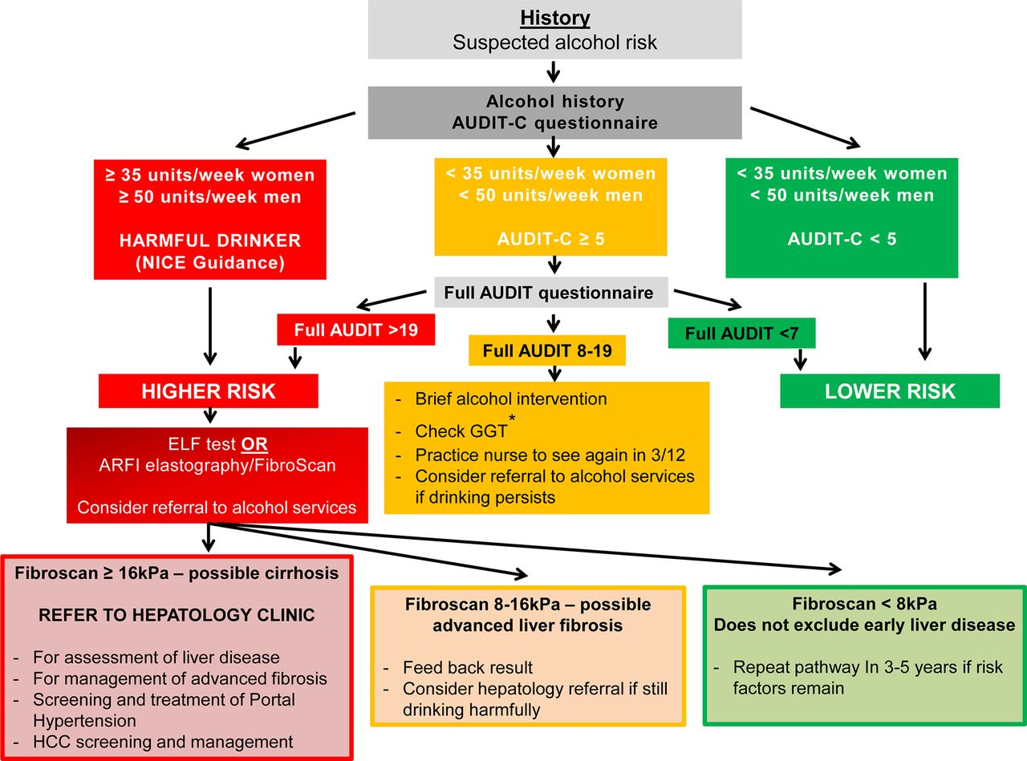
Alcohol-related liver disease algorithm.
Philip N Newsome et al. Gut 2018;67:6-19
Copyright © BMJ Publishing Group Ltd & British Society of Gastroenterology. All rights reserved.
Notes:
Alcohol-related liver disease algorithm. In patients in whom alcohol is suspected to be the main injurious factor, the extent of consumption influences early decision-making. For those drinking at harmful levels, ≥35 units/week women and ≥50 units/week men, an assessment of liver fibrosis is the critical next step. For other patients, administration of the AUDIT C questionnaire alongside brief intervention is recommended initially. For patients who continue to drink at hazardous levels consideration should be given to assessment as for the higher-risk category according to liver fibrosis evaluation. This is particularly important for those with a GGT of >100 U/L. Cut-off points for ARFI vary according to manufacturer and thus should be tailored to the device used. ARFI, acoustic radiation force impulse; ELF, enhanced liver fibrosis; GGT, γ-glutamyltransferase; HCC, hepatocellular carcinoma.

Slide 12
Imperial Alcohol Hepatology Service
Dedicated FTE Alcohol Hepatology Specialist Nurse:
Fibroscan
Extended brief interventions
Individual patient support
Strong links and referral pathways with community alcohol services
Research
Dedicated Alcohol Hepatology clinic
Consultant and Specialist Nurse
Anti-craving medications/ Brief interventions/ Alcohol services referral
St Marys Hospital AA meetings
Alcohol Care team
Representatives from:
ED, CCG, CGL (psychiatrist and clinical lead, and alcohol specialist nurse), Hepatology

Slide 13
Treatment for alcohol dependence
Mainstay of treatment is psychosocial support
NICE recommends use of adjuvant medication in those who have moderate to severe dependence

Slide 14
Brief intervention:
Short session of structured brief advice:
5-20 minute counselling session focused on individual
FRAMES – feedback, responsibility, advice, menu of strategies, empathy, self efficacy
Extended brief intervention:
Longer more motivationally-based session
Five As’ model:
Ask about use, Advice to quit or reduce, Assess willingness, Assist to quit or reduce and Arrange follow-up.
Psychotherapy with CBT, peer driven support counselling and motivational enhancement therapy can reduce relapse
Notes:
14 RCTs, 4041 patients
Brief intervention: Reduction in alcohol consumption at 6/12 and 9/12, but not maintained at 1 year
Reduction in mortality at six months and one year
Screening may have a positive impact on alcohol consumption

Slide 15
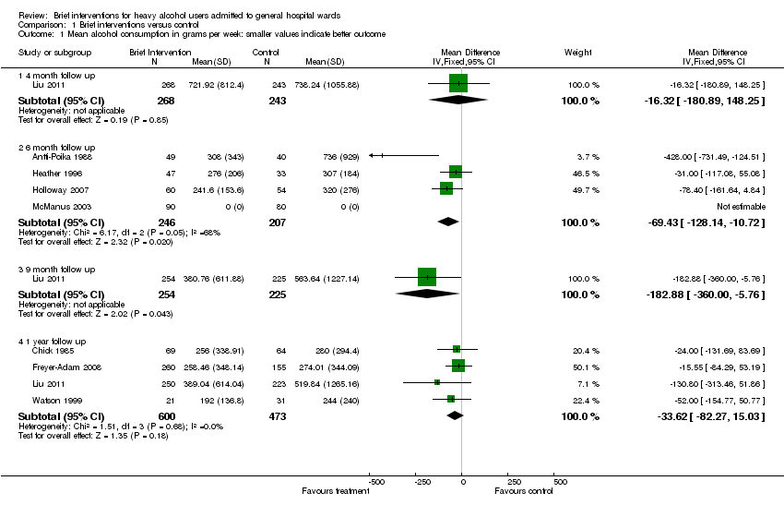
Interventions for alcohol dependence
Brief interventions for heavy alcohol users admitted to general hospital wards
Cochrane Database of Systematic Reviews 10 AUG 2011 DOI: 10.1002/14651858.CD005191.pub3 http://onlinelibrary.wiley.com/doi/10.1002/14651858.CD005191.pub3/full#CD005191-fig-00101
Notes:
Brief intervention:
Short session of structured brief advice – 5-20 minute counselling session focused on individual
FRAMES – feedback, responsibility, advice, menu of strategies, empathy, self efficacy
1 in 8 stop or reduce alcohol after brief intervention
Reduce drinking by average of 57g/ week in men
Extended brief intervention:
Longer more motivationally-based session
Five As’ model:
Ask about use, Advice to quit or reduce, Assess willingness, Assist to quit or reduce and Arrange follow-up.
Psychotherapy with CBT, peer driven support counselling and
motivational enhancement therapy can reduce relapse
14 RCTs, 4041 patients
Brief intervention: Reduction in alcohol consumption at 6/12 and 9/12, but not maintained at 1 year
Reduction in mortality at six months and one year
Screening may have a positive impact on alcohol consumption

Slide 16
Brief Interventions
Brief interventions (BI) can reduce drinking by 13-34 % (Whitlock et al)
NNT with BI to reduce alcohol consumption in in person is 8-12
1 in 8 stop or reduce alcohol after brief intervention
Highly cost effective (only taxation was more cost effective)
Reduce drinking by average of 57g/ week in men
Cochrane review found moderate quality evidence that BI reduces alcohol consumption by approx. 20 g per week compared with no intervention at one year

Slide 17
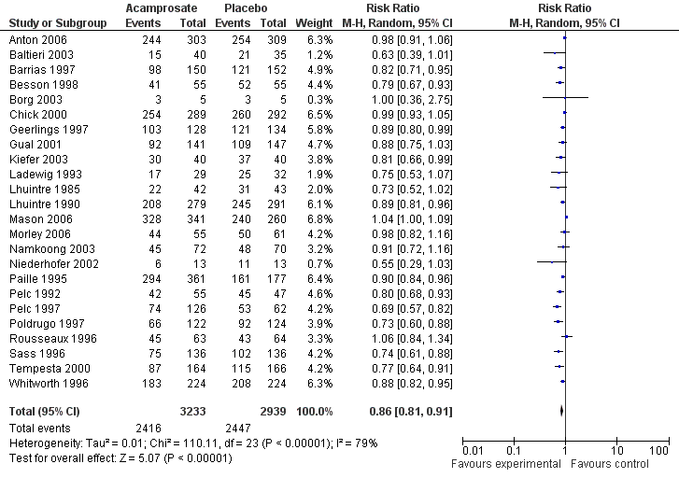
Acamprosate
Acamprosate versus placebo
Outcome: Cumulative abstinence duration.
Acamprosate versus placebo
Outcome: Return to any drinking.
Cochrane Database of Systematic Reviews 7 SEP 2010 DOI: 10.1002/14651858.CD004332.pub2 http://onlinelibrary.wiley.com/doi/10.1002/14651858.CD004332.pub2/full#CD004332-fig-0006
Notes:
Acamprosate:
Modulator of glutaminergic receptor system – glutamate antagonist, mechanism of action unclear
Cochrane meta-analysis of 24 RCTs showed
Reduction in drinking (RR 0.86 (95% CI 0.81 to 0.91), NNT 9
Increase in cumulative abstinence (MD 10.94 (95% CI 5.08 to 16.81))
Reduction in the return to any drinking with a NNT of nine
A reduction in the risk of any drinking to 86% of the placebo rate
An increase in the number of abstinent days by approximately three per month

Slide 18
Acamprosate
Mechanism of action unclear
Modulator of glutaminergic receptor system - glutamate antagonist
Not hepatically metabolised
Not specifically tested in patients with advanced liver disease
Well tolerated:
Pharmacovigilance data in 1.5 million patients showed no SAE’s
Most common AE is diarrhoea
Not addictive, safe in overdose
Contraindicated in severe renal impairment (eGFR < 30)

Slide 19
GABA receptor antagonist
Short half life of 4-6 hours
Minimally metabolised by the liver
Only therapy tested in significant alcohol related liver disease
Addolorato et al, Lancet 2007
Notes:
Baclofen is not currently licensed in the UK for the treatment of alcohol dependence
GABA Beta receptor agonist
Addolorato et al RCT double blind placebo controlled trial in alcohol dependent cirrhotics:
Baclofen 10 mg tds in treatment arm v placebo
71% of those treated maintained abstinence versus 29% of those in placebo arm
42 patients

Slide 20
Baclofen
Recommended in EASL guidelines for patients with advanced liver disease
Mixed data on efficacy
Start at 10 mg tds, titrate up to 30 mg tds
Max dose 90 mg in 24 hours
Concerns:
CNS depression (esp if relapse to alcohol use or co-prescribed other sedating medication)
May worsen mania
Reduces seizure threshold
Possible increased morbidity/ mortality in high doses

Slide 21
Naltrexone
Opioid receptor antagonist
Reduces return to heavy drinking (NNT = 9)
Hepatic metabolism
Contraindicated in:
Acute hepatitis
Acute or chronic liver failure
Use with caution:
Serum transaminase exceeding 3x ULN
Renal failure.
Cochrane Database of Systematic Reviews 8 DEC 2010 DOI: 10.1002/14651858.CD001867.pub3 http://onlinelibrary.wiley.com/doi/10.1002/14651858.CD001867.pub3/full#CD001867-fig-0005
Notes:
Naltrexone:
Cochrane meta-analysis 50 RCTs showed efficacy:
Can cause hepatocellular injury
Competitive antagonist for mu opioid receptors
The mechanism of its beneﬁcial effect in the treatment of alcohol dependence is not fully understood although it is believed to reduce the reward effects of alcohol by modulating the dopaminergic mesolimbic pathway
Increased plasma naltrexone concentrations have been reported in patients with cirrhosis.
Naltrexone does not interact with alcohol and does not have addictive potential.
The most commonly reported side-effects are nausea, vomiting, dizziness, abdominal pain, reduced appetite, headache and daytime sleepiness; these are dose-dependent and appear to be worse in women.46 Hepatotoxicity has been reported in association with use of naltrexone in doses of >300 mg/day to treat obesity.60 However, reviews of the available safety data have conﬁrmed that hepatic toxicity is very unlikely to occur with the standard daily dose of 50 mg.
Disulfiram:
Literature cites cases of fulminant hepatic failure requiring liver transplant
Avoid in liver disease

Slide 22
Outcomes of treatment for alcohol dependence
Over 10 years:
One third continuing alcohol use disorder
One third some improvement
One third good outcome (abstinence or moderate drinking)
70-80% of people entering treatment for alcohol dependence relapse
If abstinent for over one year the risk of relapse is low
Age adjusted mortality is 4 x the non-alcohol dependent population
Notes:
Increase in mortality mostly related to concomitant tobacco use associated disease – cardiovascular and aerodigestive malignancies

Slide 23
Questions?
heather.lewis4@nhs.net

Slide 24
Non-invasive fibrosis markers in ALD
Liver fibrosis markers in alcoholic liver disease, Chrostek et al, 2014
Notes:
APRI score – 13.2% sensitivity, 77.6% specificity for significant fibrosis, 20% misclassified

