Slide 1
1. ERS and Primary/Secondary Care 2. Primary HPV Screening
Deirdre Lyons
Consultant Gynaecologist

Slide 2
ERS

Slide 3
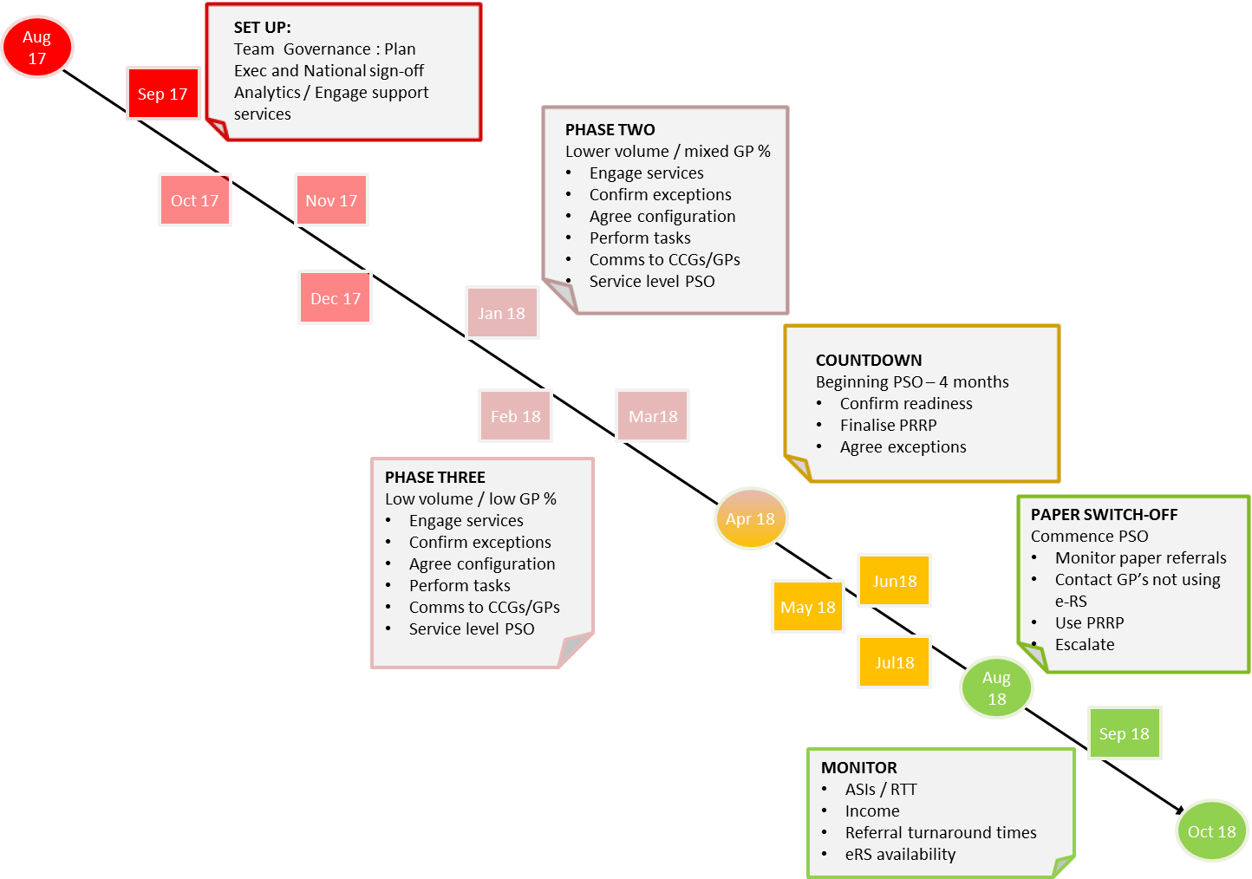
ICHNT is in Wave 3 of the London pipeline, with a delivery period running from August 2017 to August 2018
Time Line:

Slide 5
Paper Switch Off
1st August 2018 – Paper Switch-off for Imperial – all GP referrals to consultant led services should be received via e-RS from this date.
A ‘Paper Referral Return Process’ (PRRP) has been agreed with commissioners to reject referrals received outside of e-RS between the period of 1st August – 30th September 2018.
From 1st October 2018 – it is a contractual requirement for GPs to refer all patients via e-RS. Any referrals still received outside of e-RS will be notified to the relevant CCG.
The PRRP will be managed centrally through the Patient Service Centre (PSC) – all GP referrals received on paper outside of the PSC should be emailed to ICHC-tr.imperialreferrals@nhs.net

Slide 7
Directly Bookable
Where direct booking is available, the patient will leave the GP practice with either:
an appointment, booked with their chosen provider on a date and at a time that is convenient to them, or
the information necessary to enable them to make their choice of provider and to book, either via the Internet or through the Telephone Appointments Line.
Both the patient and the referring clinician have certainty about the next step on their pathway, while providers reduce the time spent arranging appointments.
Of course, this is very much dependent on the capacity made available to e-RS….
Patients express a very high level of satisfaction with such arrangements, and evidence shows that the level of missed appointments is significantly reduced.

Slide 8
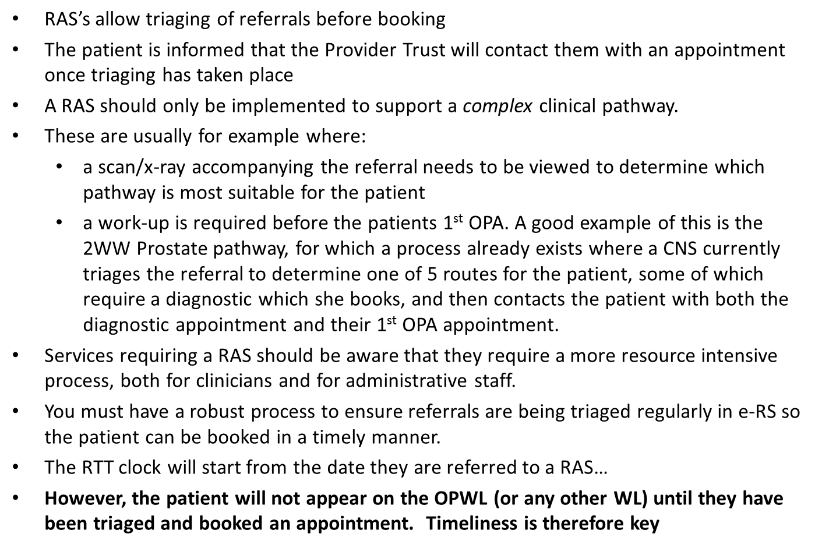
Referral Assessment Services (RAS)
Subtitle

Slide 9
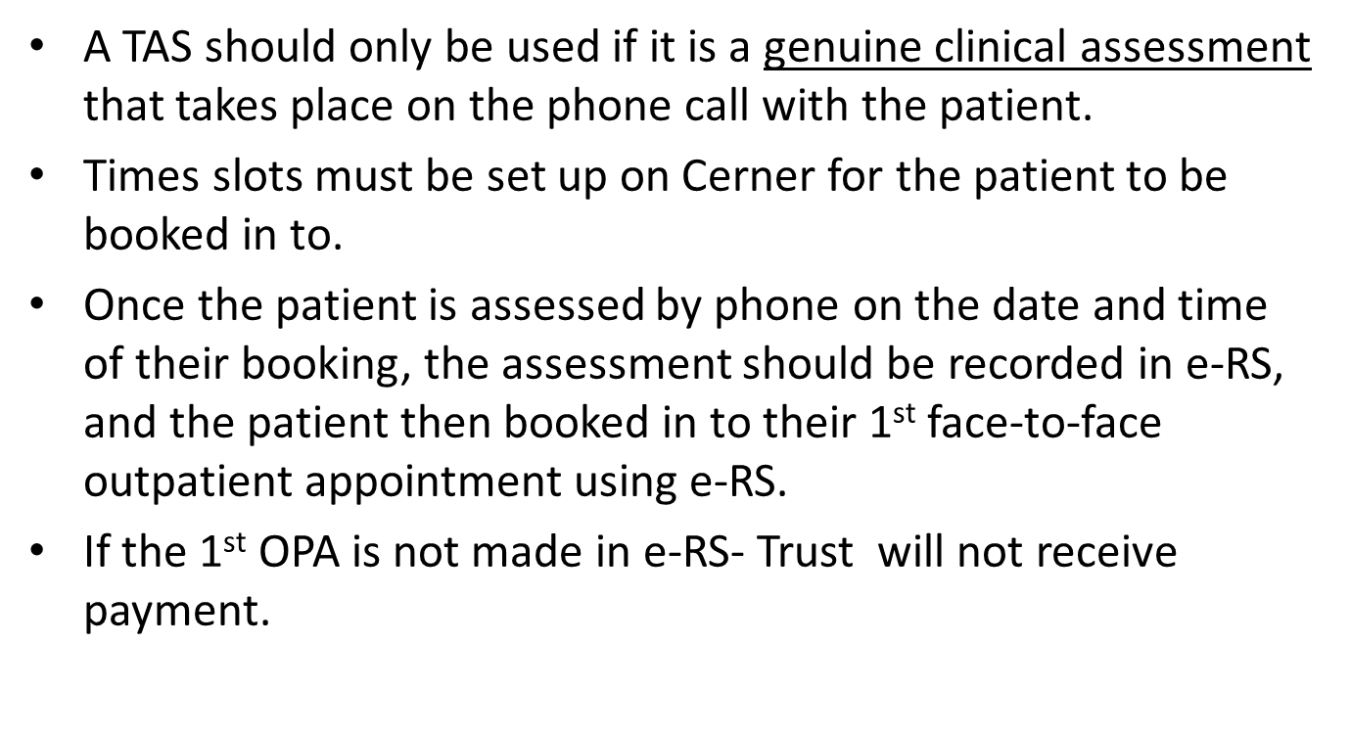
Telephone Assessment Service (TAS)

Slide 10
APPOINTMENT SLOT ISSUES (ASI’s)
Subtitle

Slide 12
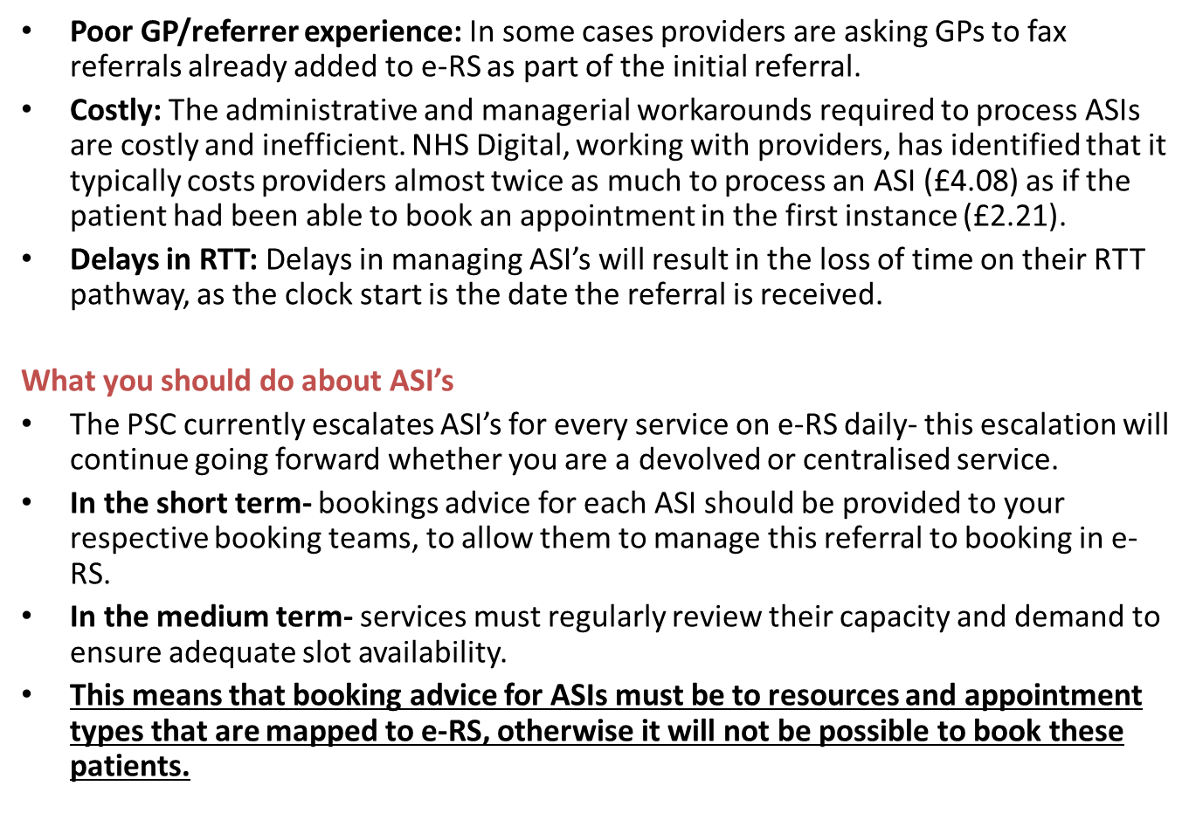
Subtitle

Slide 13
Polling Ranges

Slide 15
Paper Referral Return Process

Slide 16
Paper Referral Internal Escalation Process
1
Paper referral recieved
Date recieved is stamped/noted on referral
2
Referral is scanned (if received by fax or post) and attached to email.
Email with referral attached is sent to ICHC-tr.imperialreferrals@nhs.net with the subject 'Paper Referral Escalation'.
3
CBO recieve referral, and initiate Paper Referral Reject Process
GP and CCG is notified of referral rejection
Referral is inspected to check it is a:
GP referral to a consultant led outpatient service
Is not on the exclusions list
This must take place within 1 working day

Slide 17
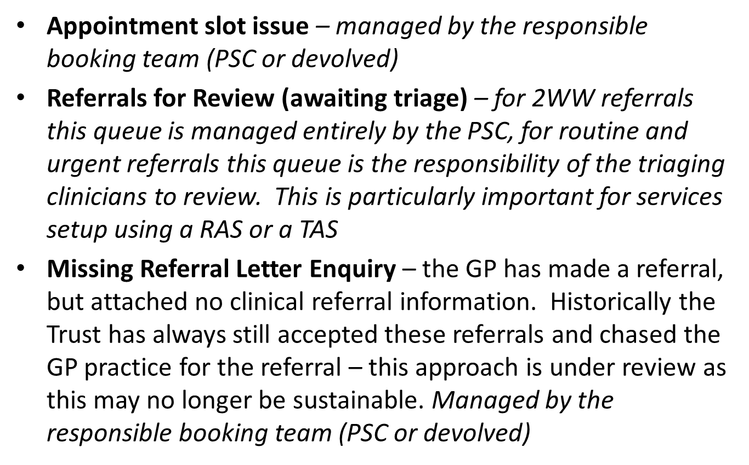
Worklists on e-RS

Slide 18
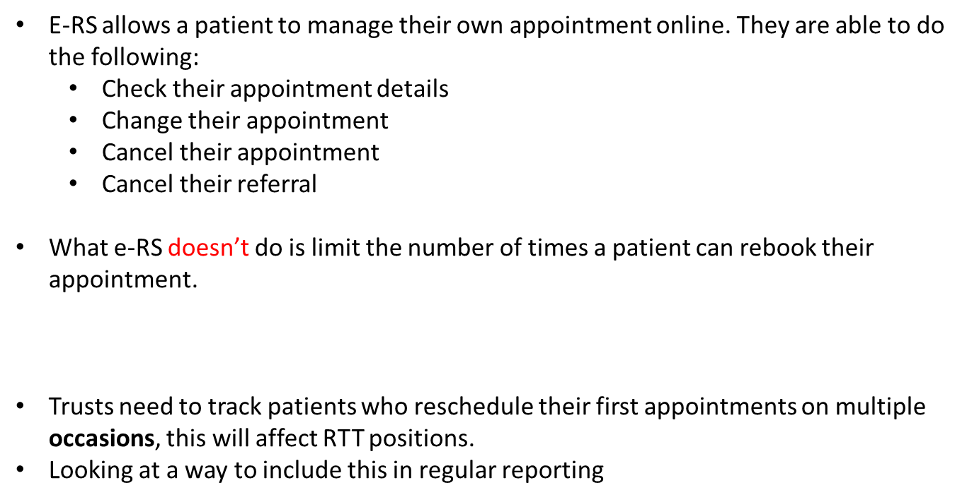
Patient Initiated Cancellations in e-RS

Slide 19
ERS Triage

Slide 20
Multiple Attachments

Slide 21
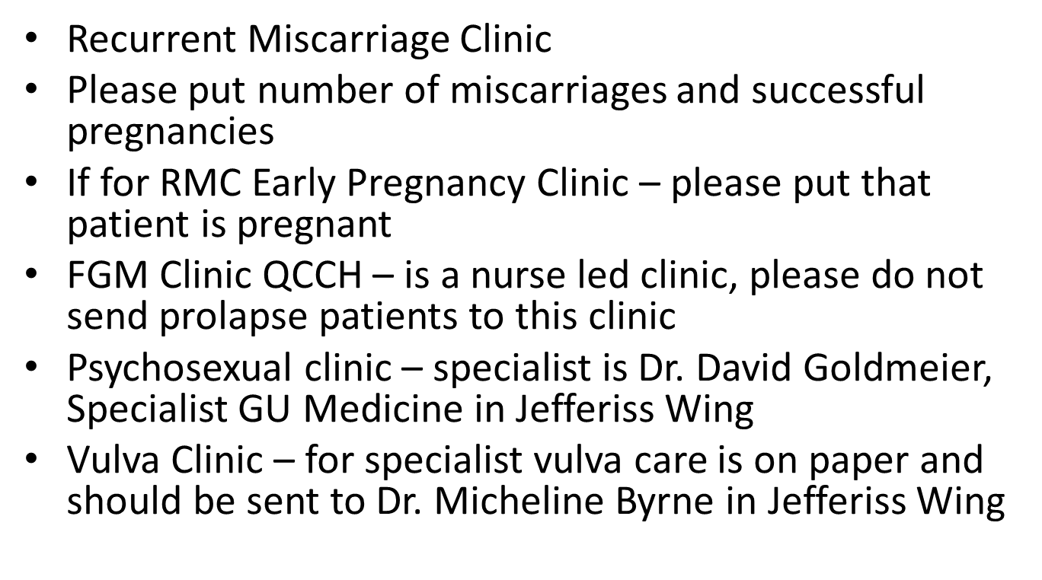
Issues with ERS

Slide 22
HPV Primary Screening

Slide 23
HPV Prevalence

Slide 24
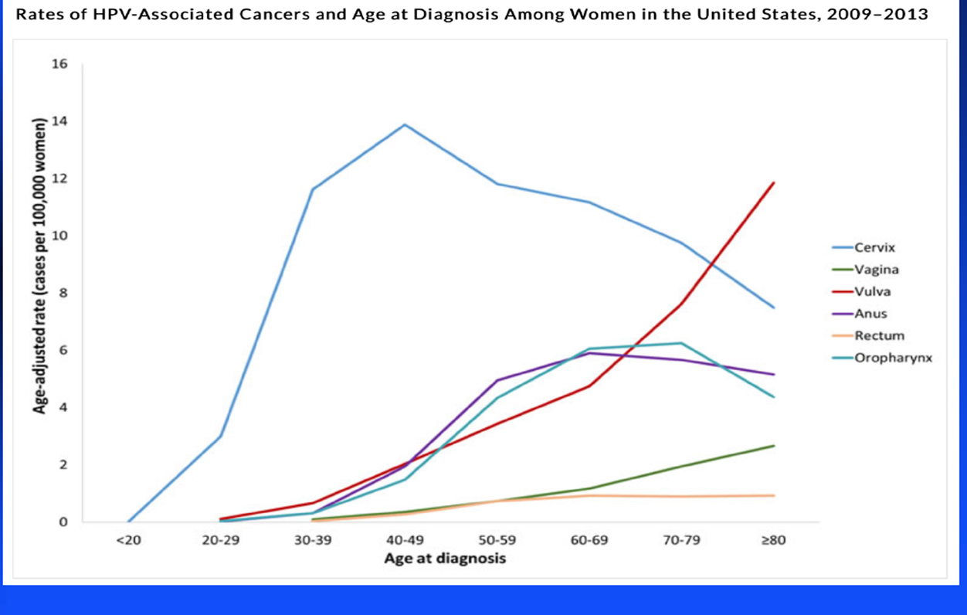
HPV Associated Disease

Slide 25
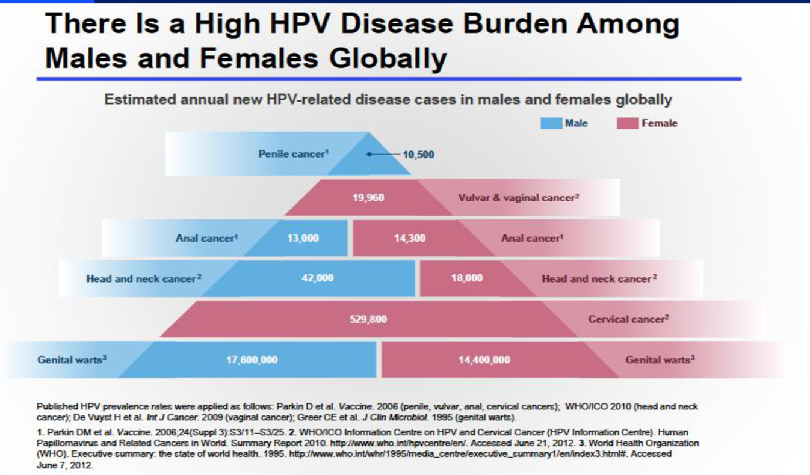
HPV Associated Disease

Slide 26
HPV Lifecycle

Slide 31
Primary HPV Screening

Slide 32
Primary HPV Screening

Slide 33
Primary HPV Screening

Slide 34
Primary HPV Screening

Slide 36
Primary HPV Screening

Slide 37
HPV Primary Screening Training

Slide 38
PHE Website

Slide 39
HPV Primary Screening Training

Slide 40
HPV Primary Screening Training

Slide 42
ERS and Primary HPV Screening

